Slide 1


Introduction to Competitive Programming
Week 3: Data Structures
Notes:
https://join.slack.com/t/introductiont-c5a2137/shared_invite/zt-djtdwpqu-S_tju9SZhk2IKhcYICitCQ

Slide 2
Bookkeeping
Survey
Anonymous
Here
Homework
Slack: Here
Group homework sessions
Code live with me
After class / Schedule some other time

Slide 3
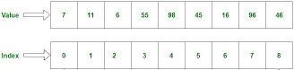
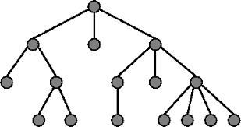
What is a data structure?*
Array
“A particular way of organizing data in a computer so that it can be used effectively.” - G4G.org
Operations
Access
Modify
Query
Tree

Slide 4
1.
Linear

Slide 5
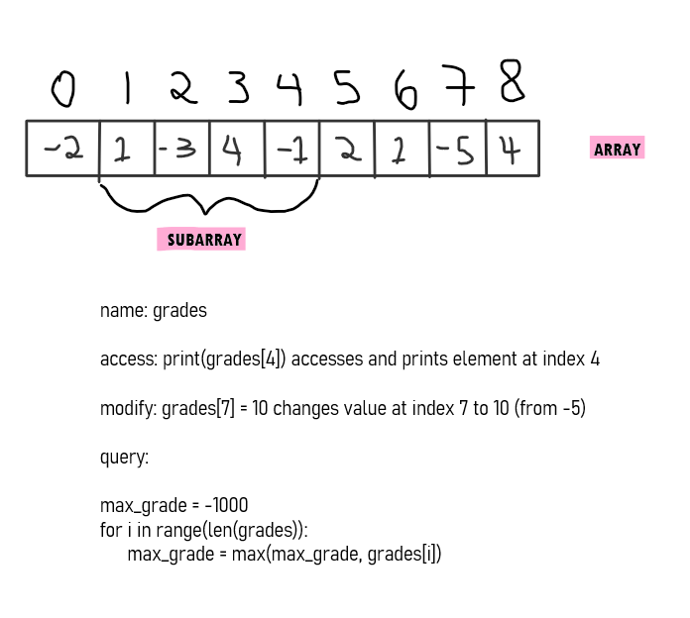
Recall the array…

Slide 6
Recall the array…
Jupyter
append
len

Slide 7
Queue
Suppose we wanted to model a line of customers in code.
FIFO (first in, first out)

Slide 8
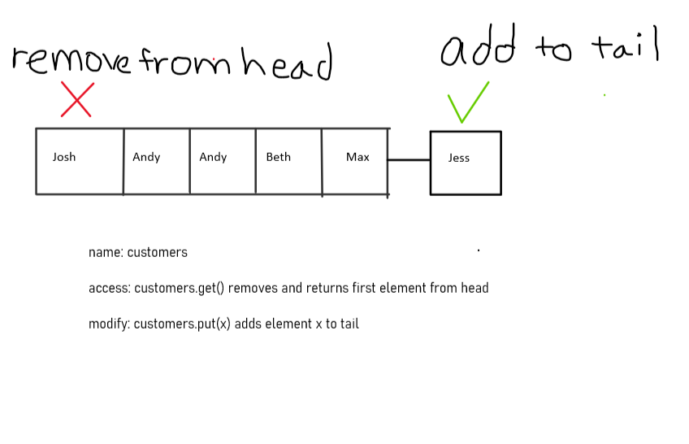
Queue
Suppose we wanted to model a line of customers in code.
FIFO (first in, first out)

Slide 9
Queue
Suppose we wanted to model a line of customers in code.
FIFO (first in, first out)
Jupyter

Slide 10
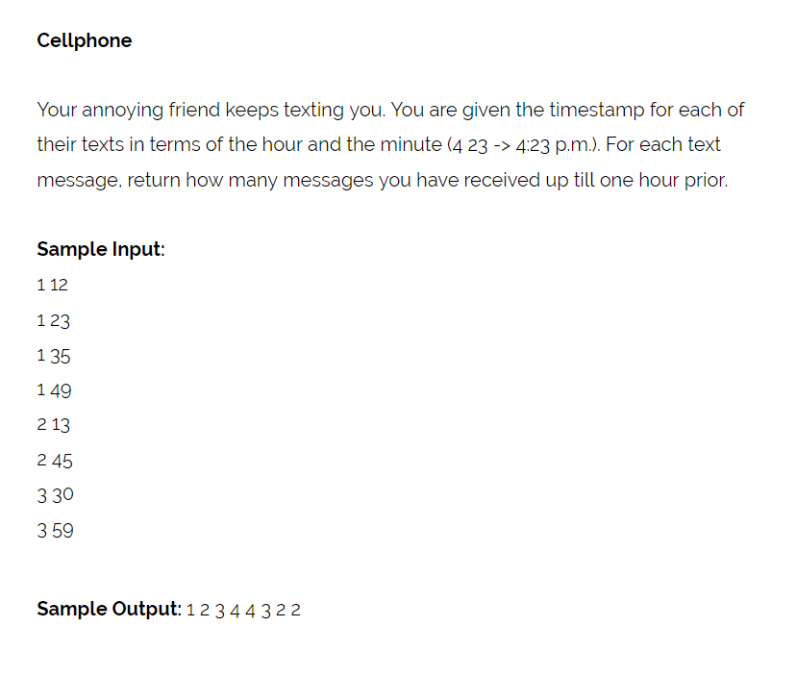
A Problem!

Slide 11
2.
Non-linear

Slide 12
Hash Tables
Suppose we have to keep track of how much money different people have (poker)
Operations:
Add a new player with name s
Access how much money person named s has
Update the money that person s has by u

Slide 13
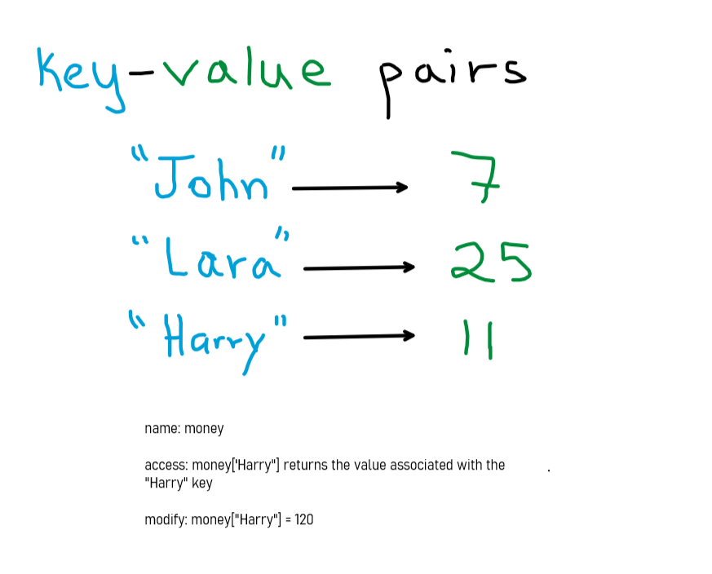
Hash Tables
Suppose we have to keep track of how much money different people have (poker)
Just like an array!
O(1) access, modify

Slide 14
Hash Tables
Suppose we have to keep track of how much money different people have (poker)
Jupyter

Slide 15
Hash Sets
Suppose we have a set of numbers, and we wish to query whether or not a value exists in our set efficiently
Naive: Maintain a list of all the numbers. Linear search to query

Slide 16
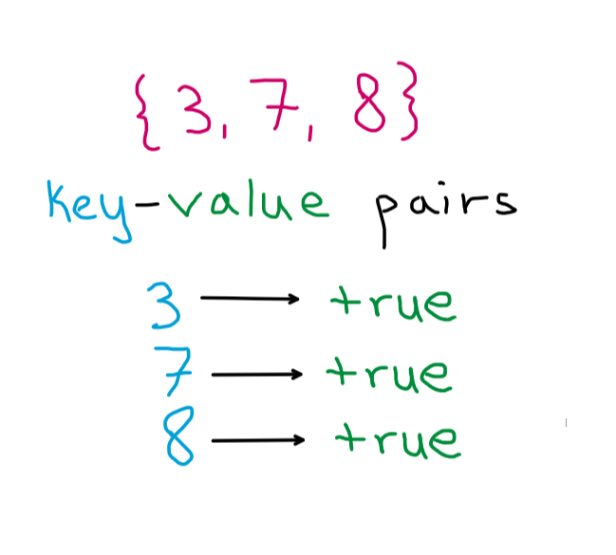
Hash Sets
Suppose we have a set of numbers, and we wish to query whether or not a value exists in our set efficiently
Just like an array!
O(1) check, modify

Slide 17
Hash Sets
Suppose we have a set of numbers, and we wish to query whether or not a value exists in our set efficiently
Jupyter

Slide 18
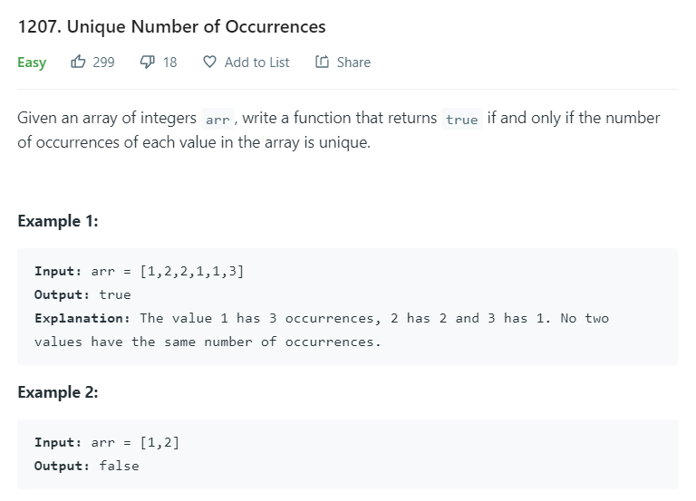
Let’s apply our knowledge

Slide 19
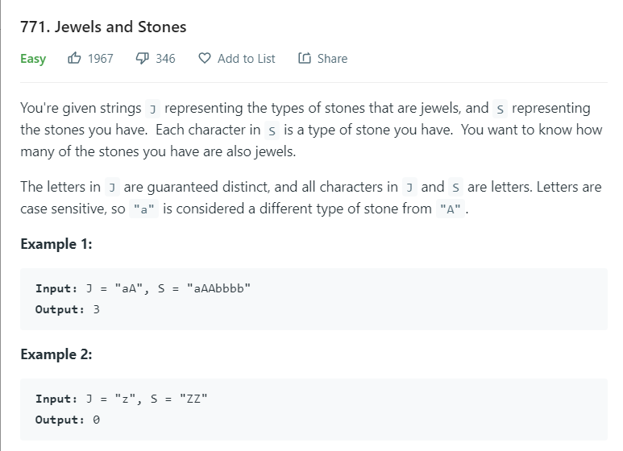
Let’s apply our knowledge

Slide 20
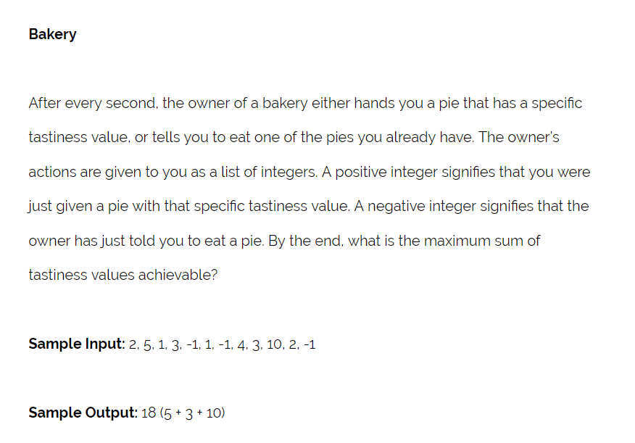
Priority Queue

Slide 21
Priority Queue
Jupyter

Slide 22
4.
Endnotes

Slide 23
Homework
Week 3: Data Structures
What operations do we need to perform on the data?
Pick data structure accordingly
Array, queue, map, set
Highly encouraged
4-5 / week
Discussed on Slack
Leetcode

Slide 24
5.
Live Coding

